Slide 1
Opacus and PySyft Package Use Example

Slide 2
Differential Privacy with Opacus
Federated Learning with Syft

Slide 3
Differential Privacy with Opacus
Federated Learning with Syft

Slide 4

Opacus Introduction
Opacus is a library that enables training PyTorch models with differential privacy. It supports training with minimal code changes required on the client, has little impact on training performance and allows the client to online track the privacy budget expended at any given moment.

Slide 5
Opacus Installation
Opacus can be installed via pip:
pip install opacus
Or, alternatively, via conda:
conda install –c conda-forge opacus

Slide 6
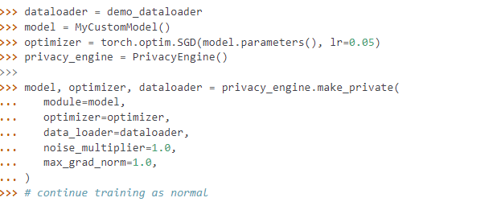
Opacus Usage
Opacus provides a high-level encapsulation of your model, optimizer and dataloader. We do not need to modify the gradients to perform a differential privacy optimization of networks.

Slide 7
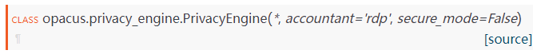
opacus.PrivacyEngine
https://opacus.ai/api/privacy_engine.html

Slide 8
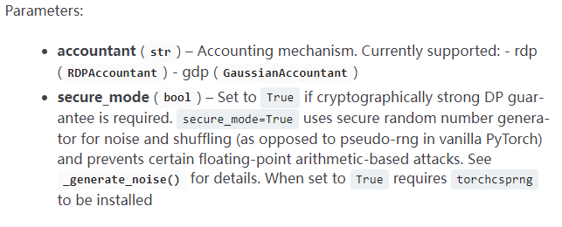
Opacus Privacy Engine Class
Parameters of class PrivacyEngine:
Accountant: Accounting mechanism, currently support rdp (RDPAccountatnt) and gdp (GaussianAccountant)
Secure_mode: If cryptographically strong DP guarantee is required.
Notes:
Accountant: Different methods to compute privacy cost. Different types of DP
R\'enyi differential privacy (RDP)
We can think of each query as a privacy ‘expense’ which incurs an incremental privacy loss. The strategy of using budgets, expenses and losses is fittingly known as privacy accounting [11].
Accountant: Different types of DP
Return privacy budget (epsilon) expended so far.

Slide 9
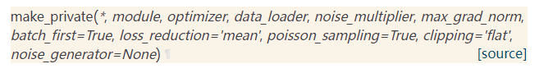
Opacus Privacy Engine Functions
Add privacy-related responsibilities to the main Pytorch training objects: model, optimizer, and the data loader.
All of the returned objects act just like their non-private counterparts passed as arguments, but with added DP tasks.

Slide 10
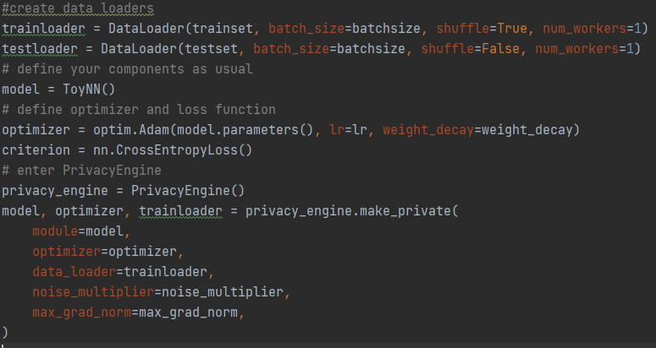
Opacus Privacy Engine Functions
Example:

Slide 11
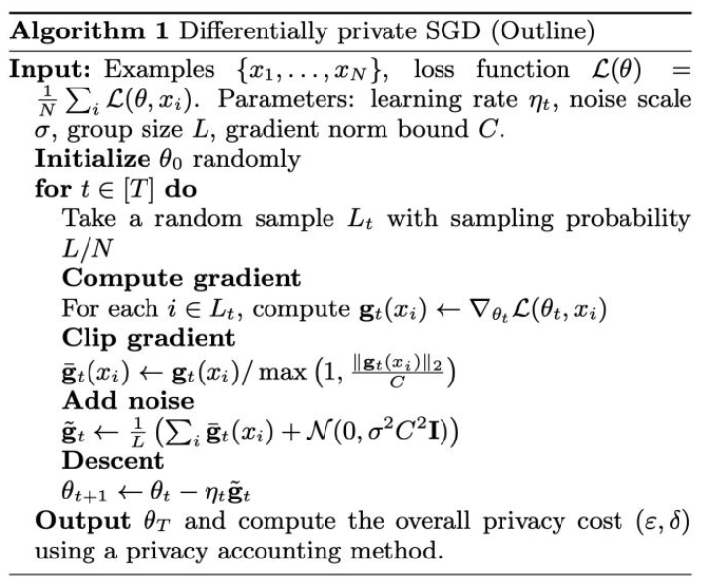
Opacus Privacy Engine Functions
Model is wrapped to also compute per sample gradients.
Optimizer is now responsible for per-sample gradient clipping and adding noise to the gradients..
Notes:
per-sample gradient clipping

Slide 12
Opacus Privacy Engine Functions
Parameters of function make_private:
module: Pytorch module to be used for training
data_loader: DataLoader to be used for training
noise_multiplier: The ratio of the standard deviation of the Gaussian noise to the L2-sensitivity of the function to which the noise is added (How much noise to add)
max_grad_norm: The maximum norm of the per-sample gradients. Any gradient with norm higher than this will be clipped to this value.

Slide 13
Opacus Privacy Engine Functions
Parameters of function make_private:
batch_first: Flag to indicate if the input tensor to the corresponding module has the first dimension representing the batch.
loss_reduction: Indicates if the loss reduction (for aggregating the gradients) is a sum or a mean operation.
poisson_sampling: ``True`` if you want to use standard sampling required for DP guarantees.

Slide 14
Opacus Privacy Engine Functions
Parameters of function make_private:
clipping: Per sample gradient clipping mechanism ("flat" or "per_layer" or "adaptive").
Flat clipping: Calculates the norm of the entire gradient over all parameters
Per Layer: Sets individual norms for every parameter tensor
Adaptive: Updates clipping bound per iteration

Slide 15
Opacus Privacy Engine Functions
Parameters of function make_private:
poisson_sampling: ``True`` if you want to use standard sampling required for DP guarantees. Setting ``False`` will leave provided data_loader unchanged. Technically this doesn't fit the assumptions made by privacy accounting mechanism, but it can be a good approximation when using Poisson sampling is unfeasible.
noise_generator: torch.Generator() object used as a source of randomness for the noise

Slide 16
Opacus Privacy Engine Functions
Return type of function make_private:
tuple [model, optimizer, DataLoader]
Model is a wrapper around the original model that also computes per sample gradients.
Optimizer is a wrapper around the original optimizer that also does per-sample gradient clipping and noise addition to the gradients.

Slide 17
Opacus Privacy Engine Functions
Return type of function make_private:
tuple [model, optimizer, DataLoader]
DataLoader is a brand new DataLoader object, constructed to behave as equivalent to the original data loader, possibly with updated sampling mechanism. Points to the same dataset object.

Slide 18
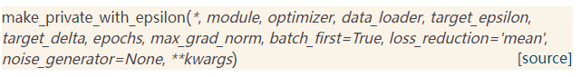
Opacus Privacy Engine Functions
Version of make_private(), that calculates privacy parameters based on a given privacy budget.
Additional Parameters of function make_private_with_epsilon:
Target_epsilon: Pre-defined epsilon
Target_delta: Pre-defined delta
Epochs: Total training epochs.

Slide 19
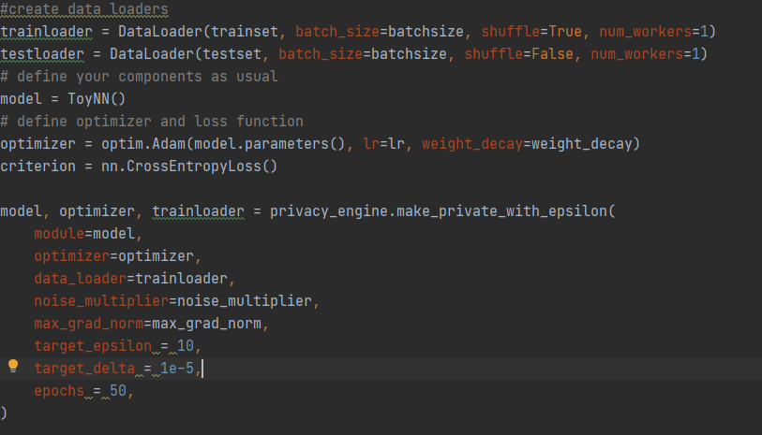
Opacus Privacy Engine Functions
Example:

Slide 20
Opacus Privacy Engine Functions
Computes the (epsilon, delta) privacy budget spent so far.
Parameters of function get_epsilon:
delta: the target delta
Example:
Notes:
Accountant.get_epsilion

Slide 21
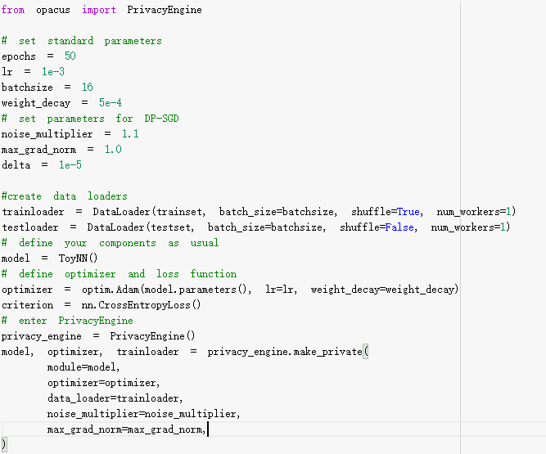
Opacus Privacy Engine Example
Import Privacy Engine from opacus
Init Privacy Engine
Call make_private function
Notes:
Move to colab

Slide 22
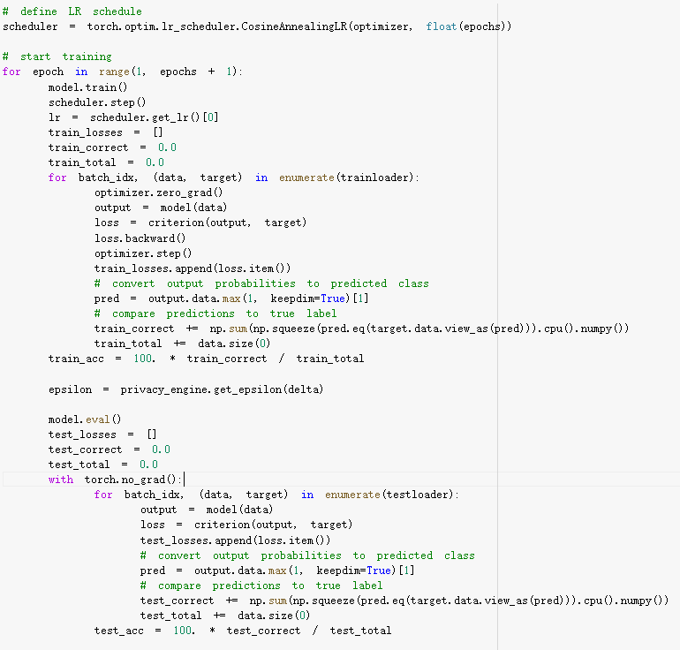
Opacus Privacy Engine Example
Call get_epsilon function

Slide 23
Differential Privacy with Opacus
Federated Learning with Syft

Slide 24
Differential Privacy with Opacus
Federated Learning with Syft

Slide 25
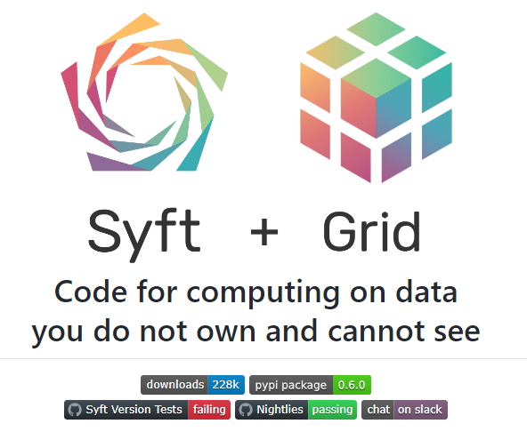
Syft Introduction
PySyft is a Python library for secure and private Deep Learning. Syft decouples private data from model training, using Federated Learning, Differential Privacy, and Encrypted Computation (like Multi-Party Computation (MPC) and Homomorphic Encryption (HE)) within the main Deep Learning frameworks like PyTorch and TensorFlow.

Slide 26
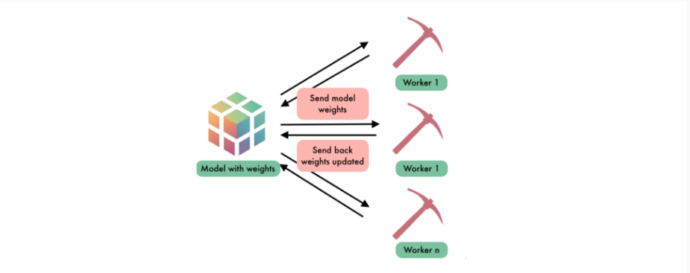
Federated Learning with Syft
PySyft can be treated as a hooked extension of PyTorch, which helps improve privacy and ownership, while the model is shared between workers.

Slide 27
Syft Installation
Syft can be installed via pip:
pip install syft

Slide 28
Syft Functions
syft.TorchHook(torch):
hook PyTorch ie add extra functionalities to support Federated Learning
syft.VirtualWorker(hook, id):
Create remote workers with id.
tensor.send(worker):
send the tensor to the remote worker.
tensor.get():
get the tensor back from the remote worker.

Slide 29
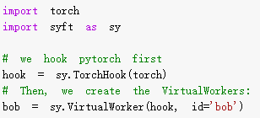
Syft Functions Examples
1. Hook PyTorch
2. Create a remote worker with id of bob.

Slide 30
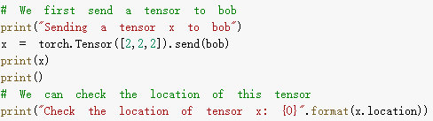
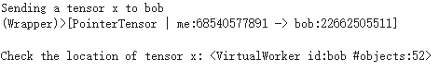
Syft Functions Examples
Send a tensor [2,2,2] to bob using send() function.
Output:

Slide 31
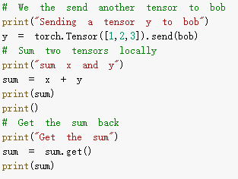
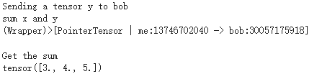
Syft Functions Examples
Send another tensor [1,2,3] to bob using send() function.
Sum=x+y is wrapped by a pointer tensor to remote worker.
Output:
Get sum back using get function

Slide 32
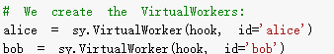
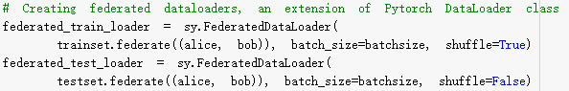
Syft.FederatedDataLoader
To perform Federated Learning, we need to split the dataset into several parts and send them to different workers. It can be easily implemented by syft.FederatedDataLoader through including workers.
Example:

Slide 33
Syft with Federated Learning Example
Server
1. Send model
4. Send model
3. Get model Back
6. Get model Back
Bob
Alice
2. Local training
5. Local training

Slide 34
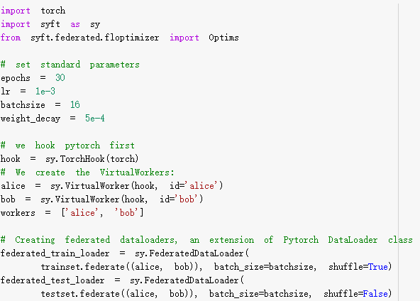
Syft with Federated Learning Example
Import syft and PyTorch
Hook PyTorch
Init Workers
Wrap Federated Data Loader

Slide 35
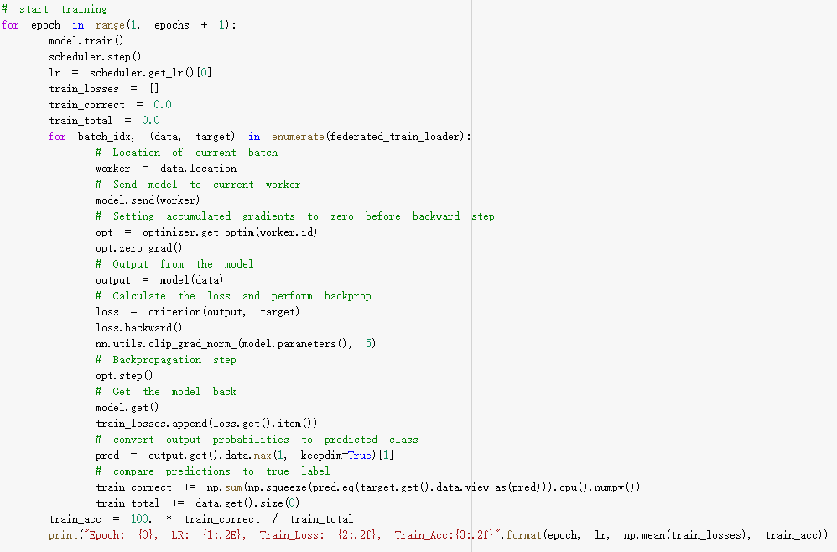
Syft with Federated Learning Example
Get the location of current batch
Send model to worker
Remote backward
Get the model back

